Slide 1
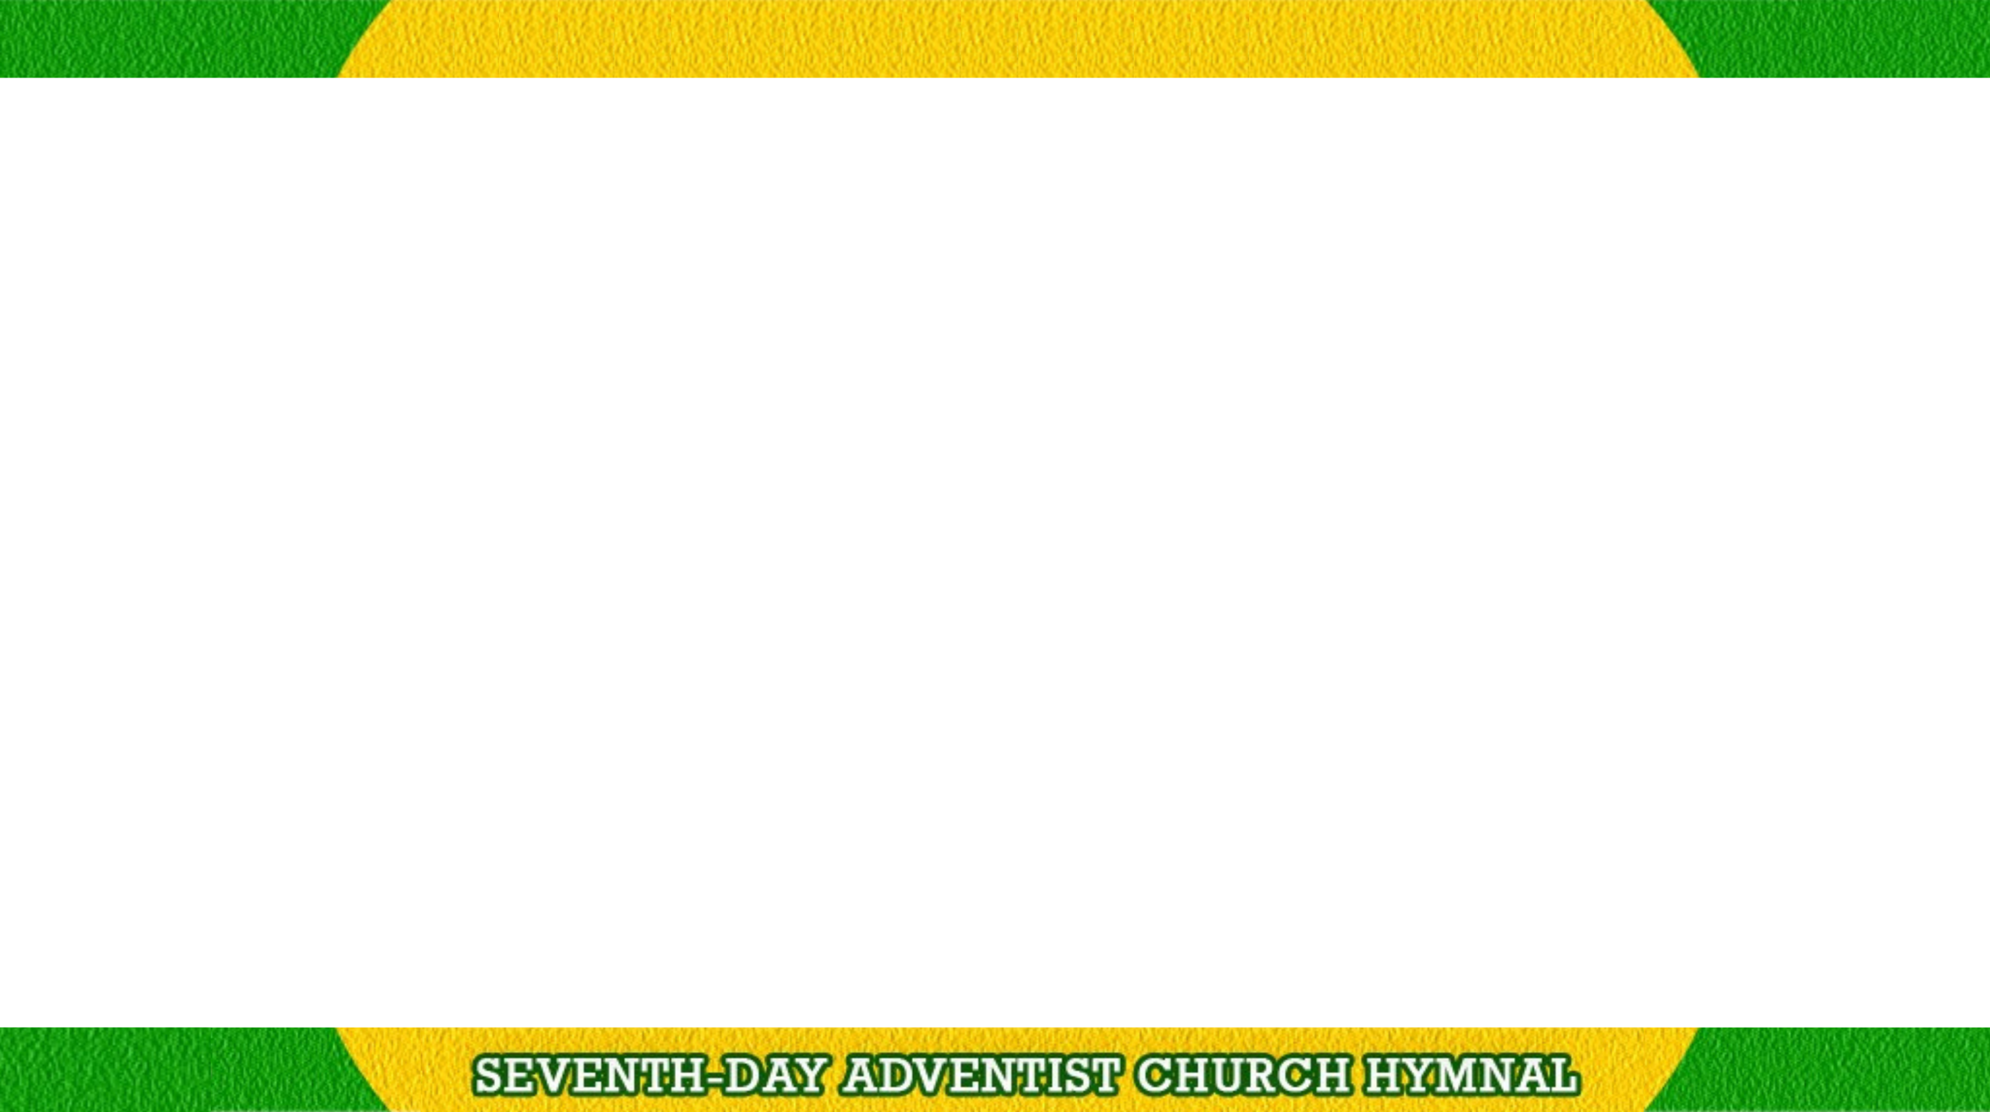
We love Thy Sabbath, Lord,
And worship at Thy will;
Oh may these hours sweet peace afford and deeper faith instill.

Slide 2
Praise for Thy wondrous love,
That sealed this sacred day,
A sign that all may understand
We own Thy sovereign sway.

